Slide 1
PASSWORD STRENGTH DETECTION
RUSHIKESH VEERAMALLY
ANVITHA KATIPALLY
SOWMYA KONERU

Slide 2
ACKNOWLEDGEMENT
We want to thank everyone involved in this initiative, we would like to thank our Mentor, Dr. Tathagata Bhattacharya, who was a constant source of inspiration for us and helped us learn a lot about this project. He encouraged us to think creatively and to do our tasks without hesitation. His ideas, wide knowledge, considerable experience, and professional skill in Cybersecurity helped us to complete this project effectively. This project would not have been accomplished without his assistance and guidance. Without the involvement of each and every individual, this endeavor would not have been a success. We were always there to encourage one another, and it was this that held us together till the end.

Slide 3
OBJECTIVES
PROBLEM
SOLUTIONS
Pro’s
Output / Solution
Conclusion and future Scope

Slide 4
Introduction
Password Strength checker is a system which is developed to provide passwords that are safe from password attackers through password pilfering.
The password checker system aims at providing security and safety of the users passwords, the system only allows users to have passwords which are restricted to a certain length with combined special characters, the password should also include the numerical with both uppercase and lowercase letters

Slide 5
OVERVIEW
CHECKS IF MEETS THE REQUIREMENT
ENTER PASSWORD
SEE IF IT’S SAFE AND SECURE
SEARCH FOR THE PASSWORD IN DATABASE

Slide 6
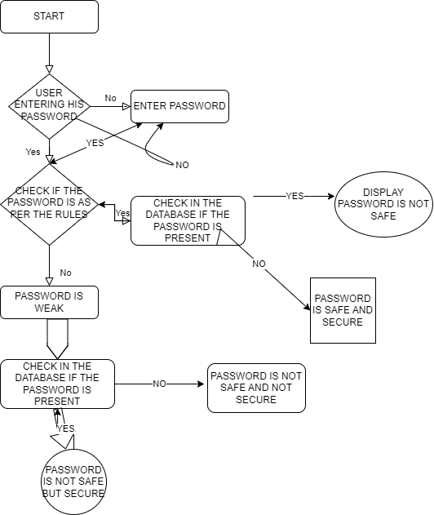
Research Work

Slide 7
How to run this?
Can run the file via live server via IDE.
Can start the Apache server and run it with the local host using XAMPP.

Slide 8
Algorithm
Length = 8 characters
Alphanumeric
Special characters
Binary Search

Slide 9
System Requirements
IDE (VS Code / Webstrom is preferred)
LATEST BROWSER
HARDWARE: INTEL/RADEON
OS – Windows
Technologies Used – HTML4, CSS3, Bootstrap 4 ,ES6, Ajax

Slide 10

OUTPUT & RESULT

Slide 11
FUTURE UPDATES/CHANGES
Securing the password database
Converting the plain text to cipher text
Enhanced UI
Chrome extension
Additional fields for email
Faster Algorithms

Slide 12
References

